Slide 1
How to Use TFLite: A Demo
Chenglin Lu
Solution R&D Android Software Platform
AI and Camera
12/20/2018
©2018 JLQ Technology Company Confidential

Slide 2
Contents
0. Background
1. TFLite Demo
2. Conclusions
2/7
2/7

Slide 3
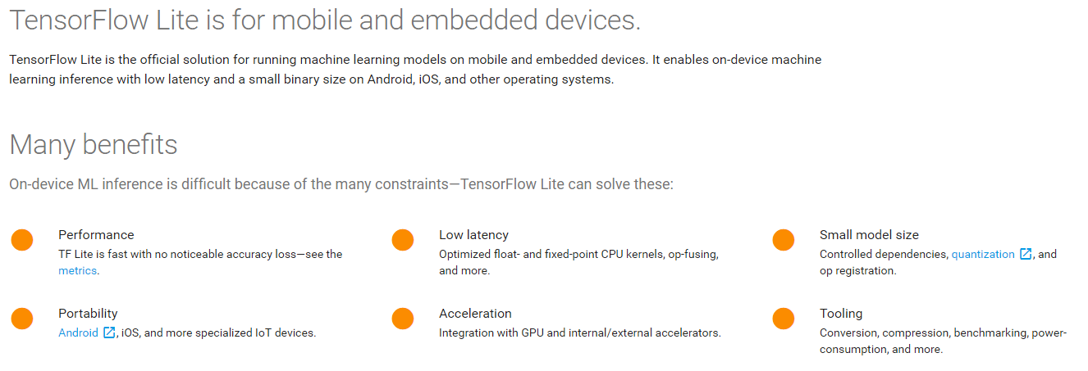
0. Background
0.1 Overview
3/7
Notes:
1. https://tensorflow.google.cn/lite/
2. https://github.com/tensorflow/tensorflow/tree/master/tensorflow/lite

Slide 4
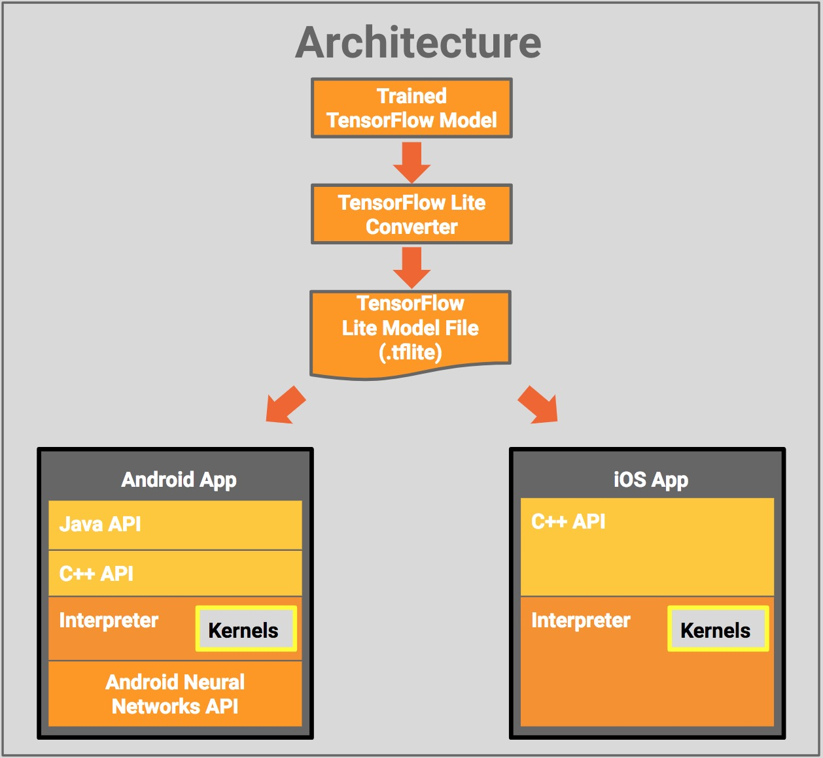
0. Background
0.2 TFLite Architecture
Model file
FlatBuffers.
Interpreter
100Kb
300Kb, kernels load.
Custom kernels.
NNAPI
Hardware acceleration.
4/7
Notes:
1. https://tensorflow.google.cn/lite/
2. https://github.com/tensorflow/tensorflow/tree/master/tensorflow/lite
3. FlatBuffers is an efficient cross platform serialization library for C++, C#, C, Go, Java, JavaScript, Lobster, Lua, TypeScript, PHP, Python, and Rust. It was originally created at Google for game development and other performance-critical applications.

Slide 5
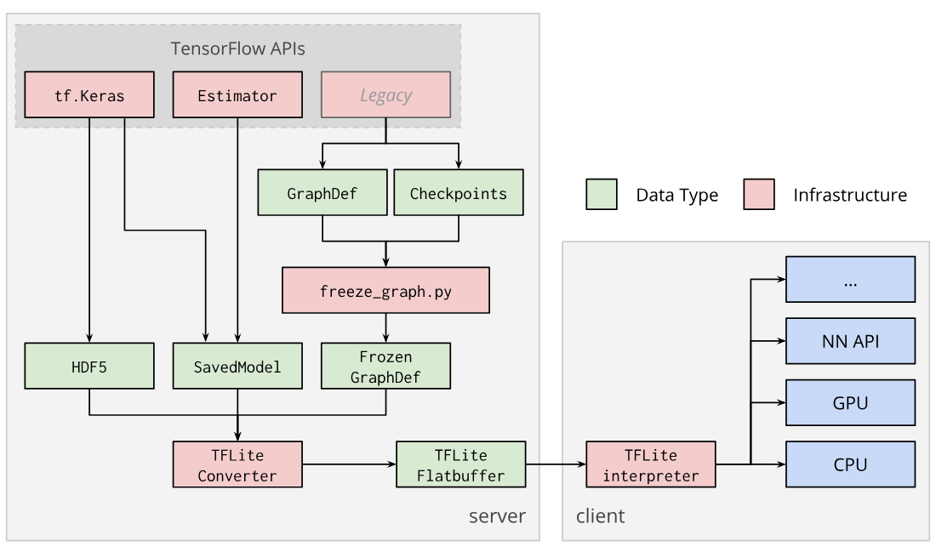
0. Background
0.3 TFLite Converter
GraphDef
Tensor, Ops, Vars def.
.pb, binary.
.pbtxt, readability.
Checkpoints
Serialized vars.
Not interpreted.
Frozen GraphDef
For Inference.
5/7
Notes:
1. https://tensorflow.google.cn/lite/convert/

Slide 6

0. Background
0.4 FlatBuffers
Why FlatBuffers?
Access to serialized data without parsing/unpacking.
Memory efficiency and speed.
Flexible.
Tiny code footprint.
Strongly typed.
Convenient to use.
Cross platform code with no dependencies.
6/7
Notes:
1.FlatBuffers is an efficient cross platform serialization library for C++, C#, C, Go, Java, JavaScript, Lobster, Lua, TypeScript, PHP, Python, and Rust. It was originally created at Google for game development and other performance-critical applications.
2. https://google.github.io/flatbuffers/

Slide 7
0. Background
0.4 FlatBuffers
Supported OS
Windows.
MacOS X.
Linux.
Android.
Others with C++ compiler.
Supported Languages
C, C++, C#
Dart, Go, Lua
Java, JavaScript, TypeScript
Lobster, PHP, Python, Rust …
7/7
Notes:
1.FlatBuffers is an efficient cross platform serialization library for C++, C#, C, Go, Java, JavaScript, Lobster, Lua, TypeScript, PHP, Python, and Rust. It was originally created at Google for game development and other performance-critical applications.
2. https://google.github.io/flatbuffers/

Slide 8
0. Background
0.5 Supported models
Models
Inception_V1, Inception_V2, Inception_V3, Inception_V4.
Mobilenet_V1, Mobilenet_V2.
ResNet_V2, Inception_ResNet_V2.
NASNet mobile/large.
SqueezeNet.
DenseNet.
MnasNet.
8/7
Notes:
1. https://github.com/tensorflow/tensorflow/blob/master/tensorflow/lite/g3doc/models.md

Slide 9
0. Background
0.5.1 Hosted Models
AutoML mobile classification models/float
Model Name | Model_Size | Top-1 Accuracy | Top-5 Accuracy | TF Lite Performance
MnasNet_0.50_224 | 8.5 Mb | 68.03% | 87.79% | 37 ms
MnasNet_0.75_224 | 12 Mb | 71.72% | 90.17% | 61 ms
MnasNet_1.0_96 | 17 Mb | 62.33% | 83.98% | 23 ms
MnasNet_1.0_128 | 17 Mb | 67.32% | 87.70% | 34 ms
MnasNet_1.0_160 | 17 Mb | 70.63% | 89.58% | 51 ms
MnasNet_1.0_192 | 17 Mb | 72.56% | 90.76% | 70 ms
MnasNet_1.0_224 | 17 Mb | 74.08% | 91.75% | 93 ms
MnasNet_1.3_224 | 24 Mb | 75.24% | 92.55% | 152 ms
9/7
Notes:
1. https://www.tensorflow.org/lite/models

Slide 10
0. Background
0.5.2 Hosted Models
Image classification models/float
Model Name | Model_Size | Top-1 Accuracy | Top-5 Accuracy | TF Lite Performance | Tensorflow Performance
DenseNet | 43.6 Mb | 64.2% | 85.6% | 894 ms | 1262 ms
SqueezeNet | 5.0 Mb | 49.0% | 72.9% | 224 ms | 255 ms
NASNet mobile | 21.4 Mb | 73.9% | 91.5% | 261 ms | 389 ms
NASNet large | 355.3 Mb | 82.6% | 96.1% | 6697 ms | 7940 ms
ResNet_V2_101 | 178.3 Mb | 76.8% | 93.6% | 1880 ms | 1970 ms
Inception_V3 | 95.3 Mb | 77.9% | 93.8% | 1433 ms | 1522 ms
Inception_V4 | 170.7 Mb | 80.1% | 95.1% | 2986 ms | 3139 ms
Inception_ResNet_V2 | 121.0 Mb | 77.5% | 94.0% | 2731 ms | 2926 ms
Mobilenet_V1_0.25_128 | 1.9 Mb | 41.4% | 66.2% | 6.2 ms | 13.0 ms
Mobilenet_V1_0.50_128 | 5.3 Mb | 56.2% | 79.3% | 18.1 ms | 29.9 ms
Mobilenet_V1_0.75_128 | 10.3Mb | 62.0% | 83.8% | 34.6ms | 48.7ms
Mobilenet_V1_1.0_128 | 16.9Mb | 65.2% | 85.7% | 57.4ms | 76.8ms
10/7
Notes:
1. https://www.tensorflow.org/lite/models

Slide 11
0. Background
0.5.3 Hosted Models
Image classification models/quantized
Model Name | Model_Size | Top-1 Accuracy | Top-5 Accuracy | TF Lite Performance
Mobilenet_V1_0.25_128_quant | 0.5 Mb | 39.5% | 64.4% | 3.7 ms
Mobilenet_V1_0.50_128_quant | 1.4 Mb | 54.9% | 78.1% | 8.8 ms
Mobilenet_V1_0.75_128_quant | 2.6 Mb | 55.9% | 79.1% | 16.2 ms
Mobilenet_V1_1.0_128_quant | 4.3 Mb | 63.3% | 84.1% | 24.9 ms
Inception_V1_quant | 6.4 Mb | 70.1% | 89.8% | 154.5 ms
Inception_V2_quant | 11 Mb | 73.5% | 91.4% | 235.0 ms
Inception_V3_quant | 23 Mb | 77.5% | 93.7% | 637 ms
Inception_V4_quant | 41 Mb | 79.5% | 93.9% | 1250.8 ms
11/7
Notes:
1. https://www.tensorflow.org/lite/models

Slide 12
0. Background
0.6 Compatibility
Supported types
Floating-point(32), quantized(uint8)
Little for tf.float16 and strings.
Data format
Only “NHWC”(TF)
tf.add, tf.mul, tf.sub, tf.div
Unsupported ops
tf.depth_to_space,
tf.image.resize_bilinear,
tf.tanh
12/7
Notes:
1. https://www.tensorflow.org/lite/tf_ops_compatibility

Slide 13
0. Background
0.7 TFLite Benchmark
Model Name | Device | Mean inference time (std dev)
Mobilenet_1.0_224(float) | Pixel 2 | 166.5 ms (2.6 ms)
 | Pixel xl | 122.9 ms (1.8 ms)
Mobilenet_1.0_224 (quant) | Pixel 2 | 69.5 ms (0.9 ms)
 | Pixel xl | 78.9 ms (2.2 ms)
NASNet_mobile | Pixel 2 | 273.8 ms (3.5 ms)
 | Pixel xl | 210.8 ms (4.2 ms)
SqueezeNet | Pixel 2 | 234.0 ms (2.1 ms)
 | Pixel xl | 158.0 ms (2.1 ms)
Inception_ResNet_V2 | Pixel 2 | 2846.0 ms (15.0 ms)
 | Pixel xl | 1973.0 ms (15.0 ms)
Inception_V4 | Pixel 2 | 3180.0 ms (11.7 ms)
 | Pixel xl | 2262.0 ms (21.0 ms)
Device | CPU_MASK
Pixel 2 | f0
Pixel xl | 0c
13/7
Notes:
1. https://tensorflow.google.cn/lite/performance/benchmarks

Slide 14
0. Background
0.8 TFLite Benchmark
Model Name | Device | Mean inference time (std dev)
Mobilenet_1.0_224(float) | iPhone 8 | 32.2 ms (0.8 ms)
Mobilenet_1.0_224 (quant) | iPhone 8 | 24.4 ms (0.8 ms)
NASNet mobile | iPhone 8 | 60.3 ms (0.6 ms)
SqueezeNet | iPhone 8 | 44.3 (0.7 ms)
Inception_ResNet_V2 | iPhone 8 | 562.4 ms (18.2 ms)
Inception_V4 | iPhone 8 | 661.0 ms (29.2 ms)
Device
iPhone 8
14/7
Notes:
1. https://tensorflow.google.cn/lite/performance/benchmarks

Slide 15
0. Background
0.9 Latency and accuracy
Model | Top-1 Accuracy (Original) | Top-1 Accuracy (PTQ) | Top-1 Accuracy (QAT) | Latency/ms (Original) | Latency (PTQ) | Latency (QAT) | Size/MB (Original) | Size (Optimized)
Mobilenet-v1-1-224 | 0.709 | 0.657 | 0.70 | 180 | 145 | 80.2 | 16.9 | 4.3
Mobilenet-v2-1-224 | 0.719 | 0.637 | 0.709 | 117 | 121 | 80.3 | 14 | 3.6
Inception_v3 | 0.78 | 0.772 | 0.775 | 1585 | 1187 | 637 | 95.7 | 23.9
Resnet_v2_101 | 0.770 | 0.768 | N/A | 3973 | 2868 | N/A | 178.3 | 44.9
15/7
Notes:
1.PTQ, Post Training Quantized, QAT,Quantization Aware Training

Slide 16
1. TFLite Demo
Step1. Choose a model.
Step2. Convert the model format.
Step3. Inference in app.
16/7

Slide 17
1. TFLite Demo
1.0 About the Demo
Resize each camera image frame to 224*224(quantized MobileNets) 299*299(Inception-v3).
TFLite Java inference API.
Output, 2-D array.
First, category index.
Second, confidence of classification.
1001 unique categories(background+ImageNet1000).
Top 3.
17/7

Slide 18
1. TFLite Demo
1.1 Three ways TF on Android
Prebuilt binary APK.
Android Studio (IDE).
Recommend
Simplest.
Just want to add TensorFlow to AS.
Bazel, ADB
Custom ops
Build from scratch.
18/7
Notes:
http://download.tensorflow.org/deps/tflite/TfLiteCameraDemo.apk
https://developer.android.com/studio/

Slide 19
1. TFLite Demo
1.2 Preparation
Android5.0 (API 21) or higher.
Model
Quantized MobileNet.
Floating point Inception_v3.
19/7

Slide 20
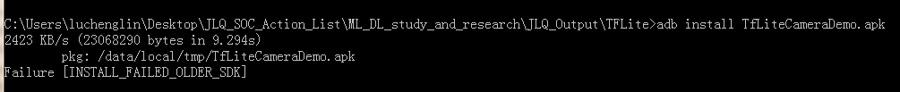
1. TFLite Demo
1.3 Prebuild binary
Download from 1 or 2.
Display
Top three objects classified.
Classification latency.
Devices: LC1860, LC1881.
20/7
Notes:
http://download.tensorflow.org/deps/tflite/TfLiteCameraDemo.apk
https://storage.googleapis.com/download.tensorflow.org/deps/tflite/TfLiteCameraDemo.apk

Slide 21
1. TFLite Demo
1.4 Build the demo using AS
Prerequisites.
Install AS
git clone https://github.com/tensorflow/tensorflow.
Android SDK>26, NDK>14.
Building
Import: tensorflow/lite/java/demo.
Build. mobilenet_quant_v1_224.tflite and labels.txt →/assets
Run → Run 'android'
21/7
Notes:
1. https://developer.android.com/studio/

Slide 22
1. TFLite Demo
1.5 Build from source
Prerequisites.
Install Bazel.
git clone https://github.com/tensorflow/tensorflow.
Android SDK>26, NDK>14, build tools API>26.0.1
Building
WORKSPACE →add SDK NDK path.
bazel build -c opt --cxxopt='--std=c++11' //tensorflow/lite/java/demo/app/src/main:TfLiteCameraDemo
Install
adb install bazel-bin/tensorflow/lite/java/demo/app/src/main/TfLiteCameraDemo.apk
22/7
Notes:
1. https://docs.bazel.build/versions/master/install.html

Slide 23
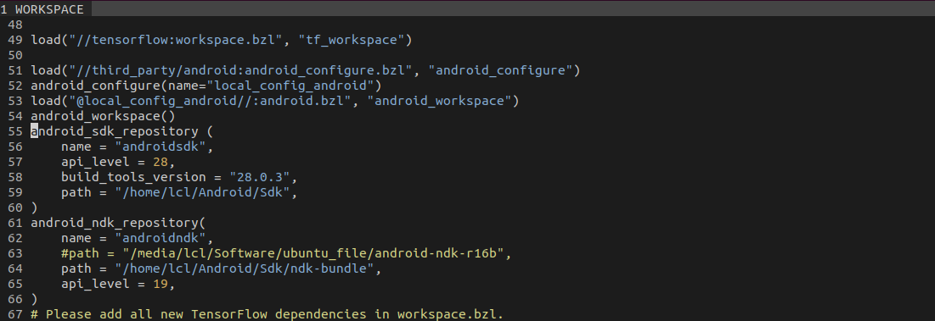
1. TFLite Demo
1.6 Test on Ubuntu18.04
WORKSPACE
23/7

Slide 24
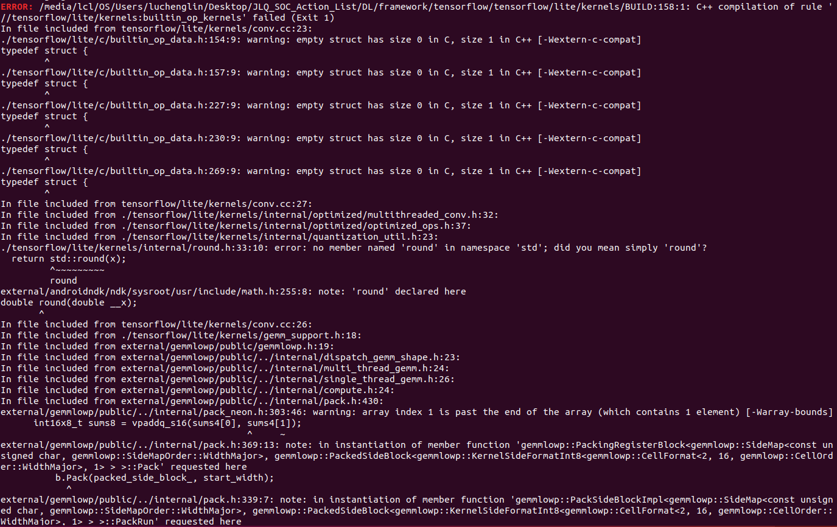
1. TFLite Demo
1.6 Test on Ubuntu18.04
NDK r16b (Error)
24/7

Slide 25
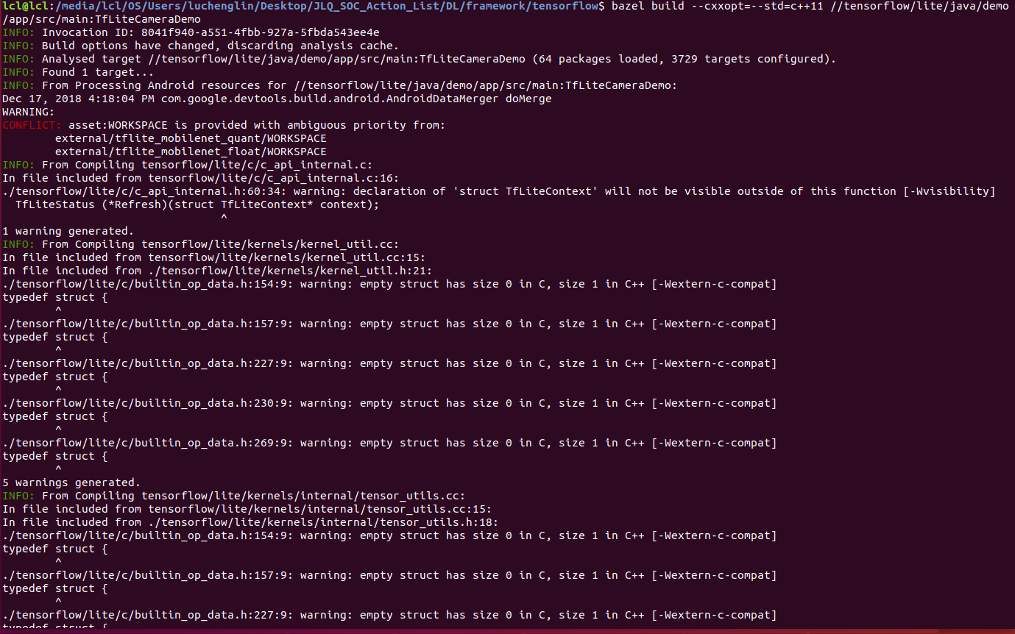
1. TFLite Demo
1.6 Test on Ubuntu18.04
NDK r18b
25/7

Slide 26
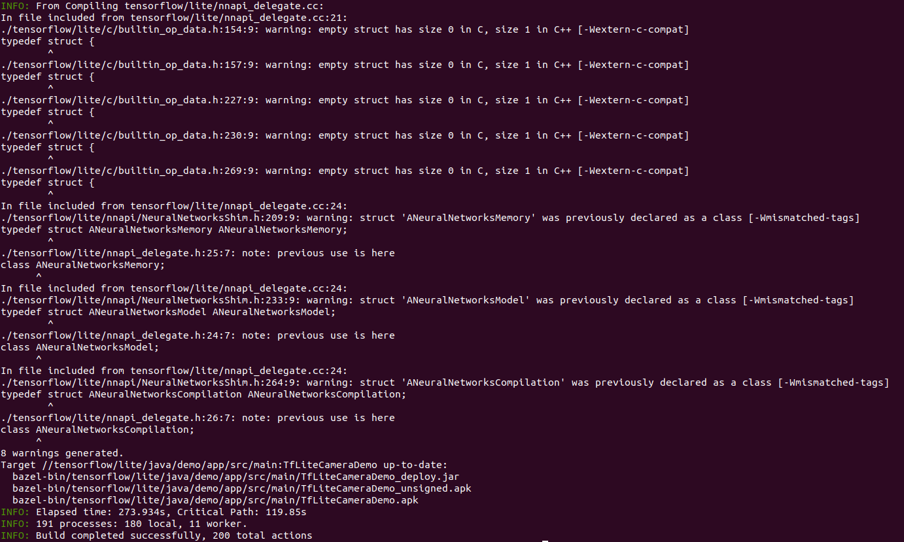
1. TFLite Demo
1.6 Test on Ubuntu18.04
NDK r18b
26/7

Slide 27
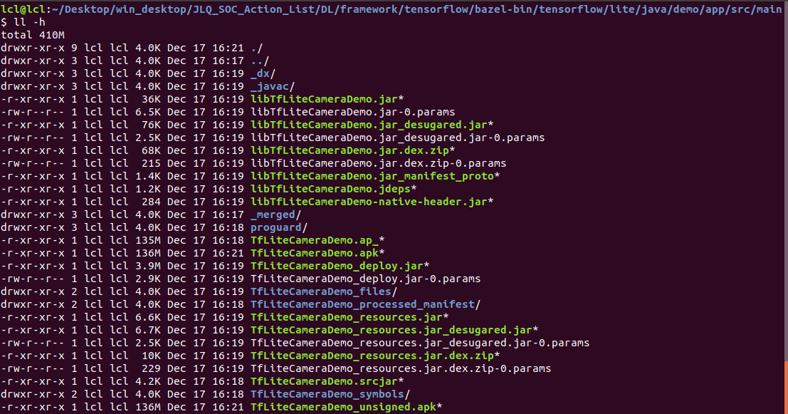
1. TFLite Demo
1.6 Test on Ubuntu18.04
27/7

Slide 28
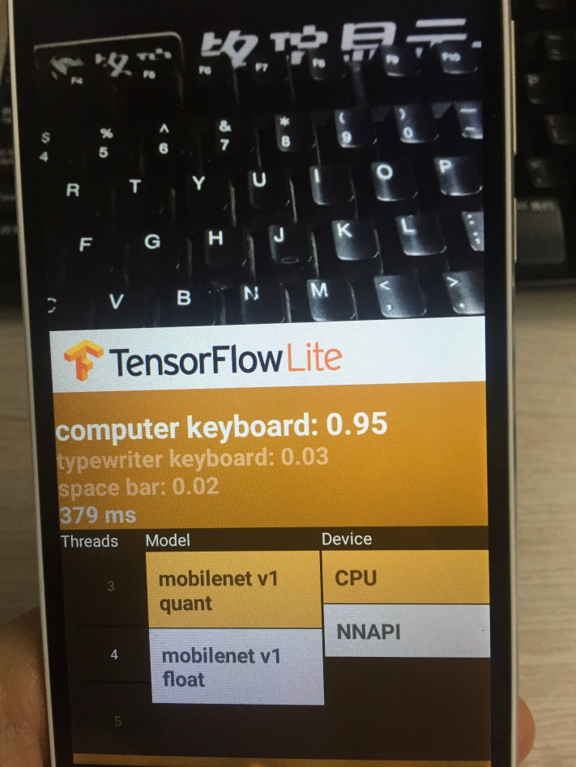
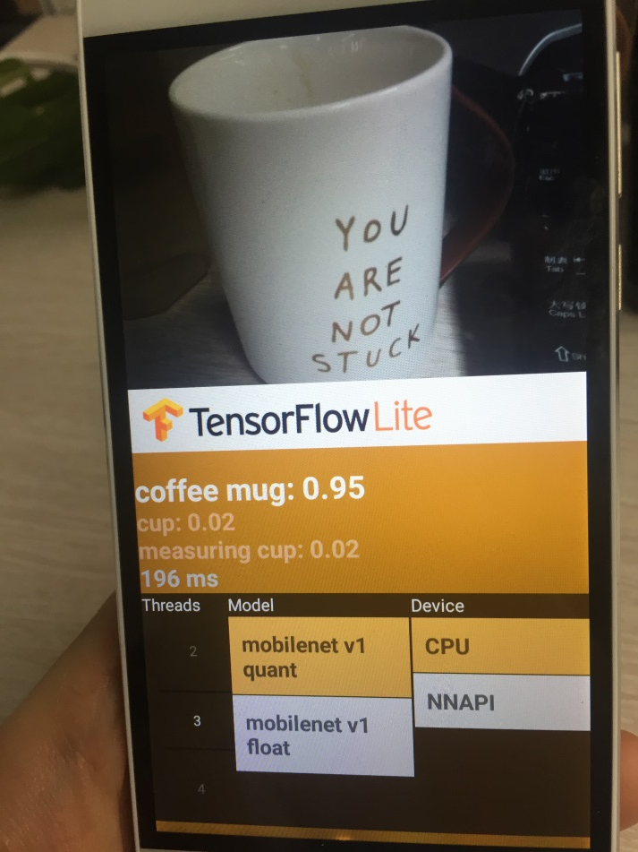
1. TFLite Demo
1.6 Test on Ubuntu18.04
28/7

Slide 29
2. Conclusions
Core ops and custom ops.
Lightweight. All supported ops smaller than 300kb.
Java and C++ API supported.
Better performance ratio.
Low latency and small binary size.
Hardware acceleration. Android NNAPI.
29/7

Slide 30
Thank you

